Slide 1
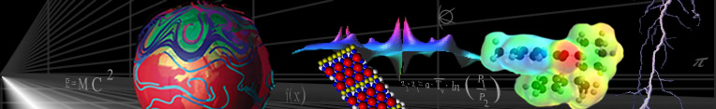

An Overview of Data Mining
D. A. Dickey
IAA
September 2024
Copyright © Time and Date AS / Steffen Thorsen 1995-2006. All rights reserved. About us | Disclaimer | Privacy Create short URL to this page | Linking | Feedback: webmaster@timeanddate.com Home page | Site Map | Site Search | Date Menu | The World Clock | Calendar | Countdown

Slide 2
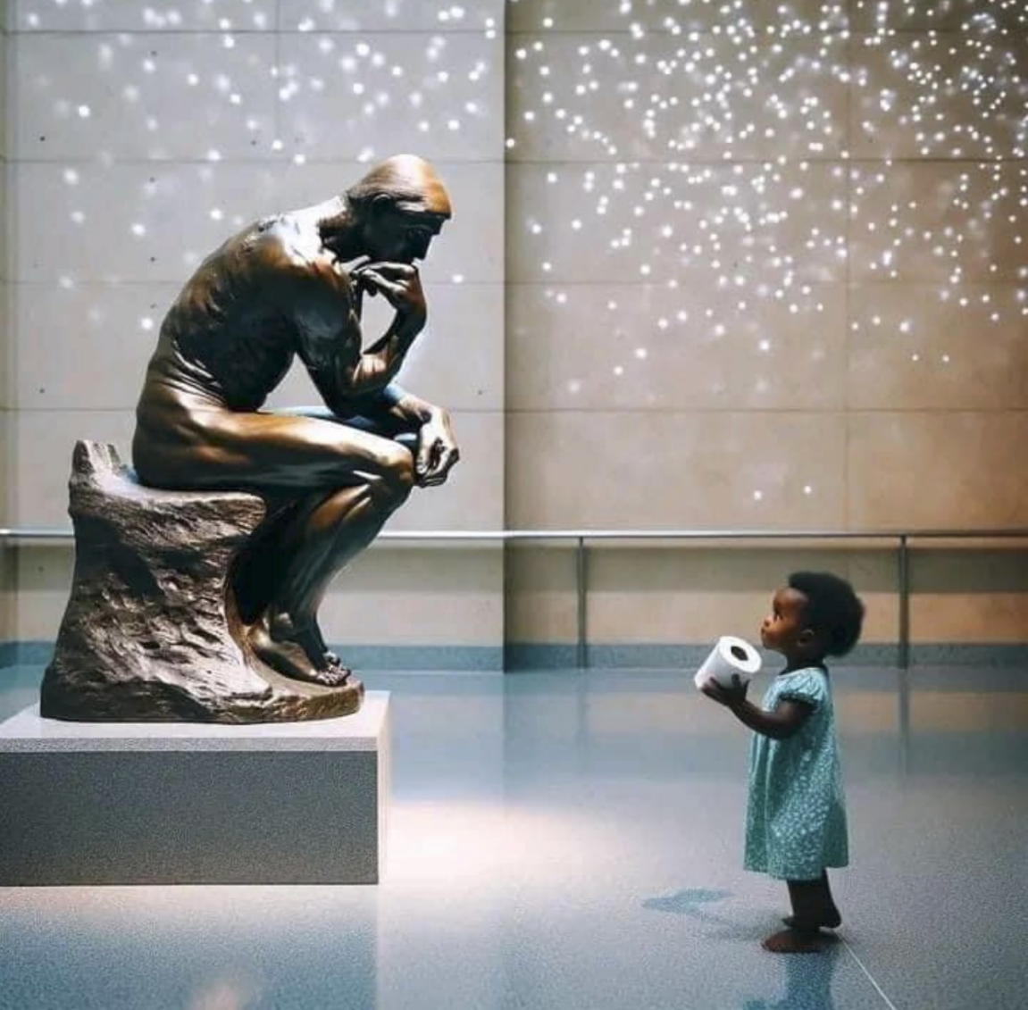
New results about Rodin’s “The Thinker” (update on time series talk)

Slide 3
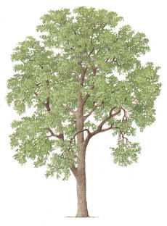
Decision Trees
A “divisive” method (splits)
Start with “root node” – all in one group
Get splitting rules
Response often binary
Result is a “tree”
Example: Loan Defaults
Example: Framingham Heart Study
Example: Covid vaccine %
Optional: Automobile Accidentsnts

Slide 4
Recursive Splitting
Representing 8 defaulters, 4*340=1360 nondefaulters
\ /
8 4
9 2
8/1368
Pr{default} =0.0058
Pr{default} =0.0131
17 6
Pr{default} =0.0020
2 3
X1=Debt
To
Income
Ratio
7 26
Pr{default} =0.0004
Pr{default} =0.0011
3 8
2 15
X2 = Age
No default (1 dot per 340)
Default (1 dot per defaulter)

Slide 5
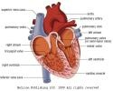
Some Actual Data
Framingham Heart Study
First Stage Coronary Heart Disease
P{CHD} = Function of:
Age - no drug yet! ☹
Cholesterol
Systolic BP
Smoking
Import

Slide 6
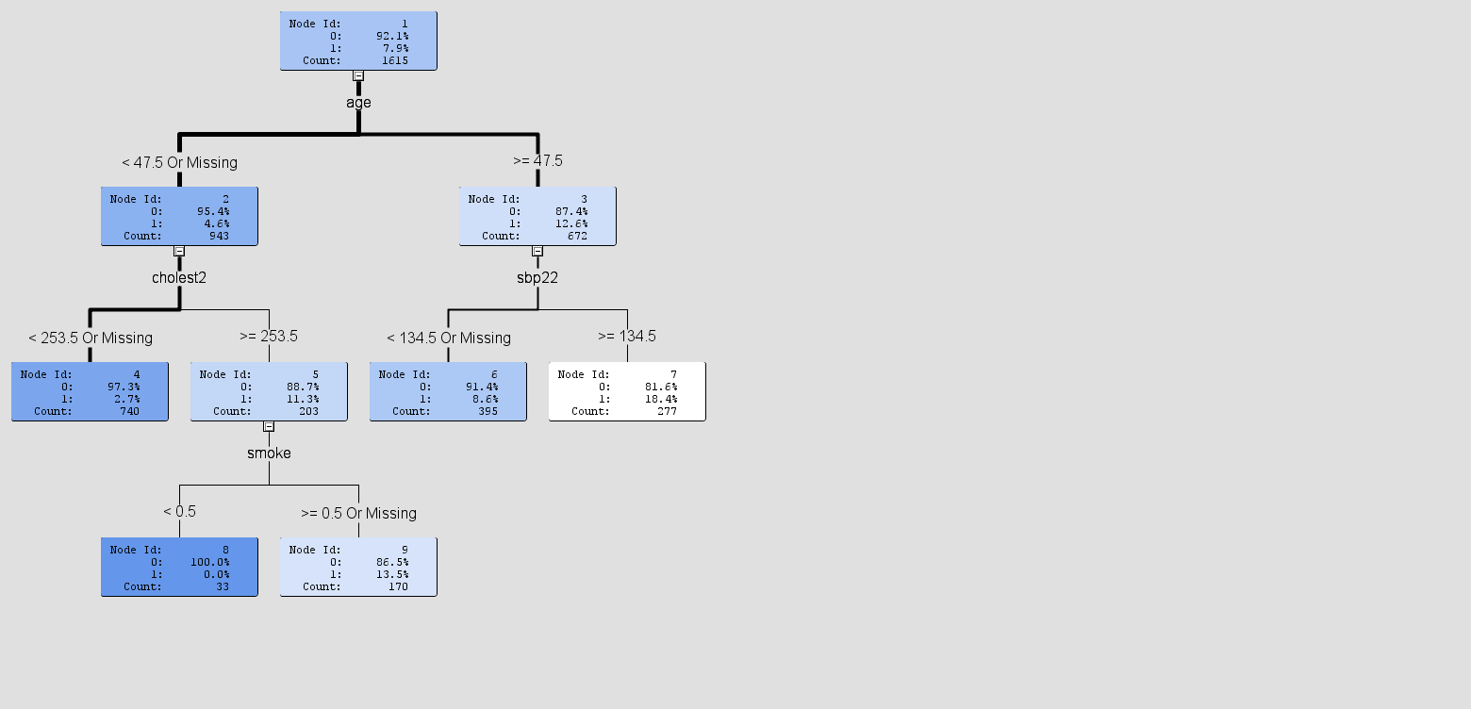
Overall
Rate 8%
5%
13%
Example of a “tree” →
Using Default Settings
3%
11%
9%
18%
No first stage
Coronary Heart
Disease (n=33)
0%
14%
Narrowest possible 95% confidence interval is 0 < Pr{0 out of 33} < 0.0868 (for random sample of 33 with no events)

Slide 7
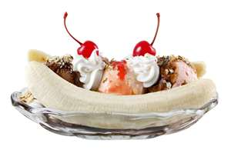
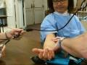
How to make splits?
Contingency tables
Heart Disease
No Yes
Heart Disease
No Yes
Low
BP
High
BP
95 | 5
55 | 45
100
100
75 | 25
75 | 25
100
100
180 ?
240?
150 50
150 50
DEPENDENT (effect)
INDEPENDENT (no effect)

Slide 8
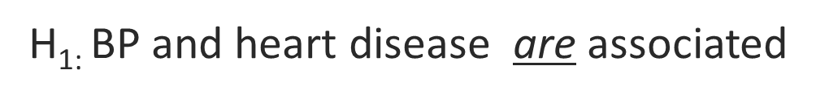
How to make splits?
Contingency tables
Observed - Expected
=
Heart Disease
No Yes
Expected
95 75 | 5 25
55 75 | 45 25
100
100
2(400/75)+ 2(400/25) = 42.67
Compare to χ² tables –>
Low
BP
High
BP
180 ?
240?
P=0.00000000064
H₀: No association
H_{1:} BP and heart disease are associated
150 50
DEPENDENT (effect)

Slide 9

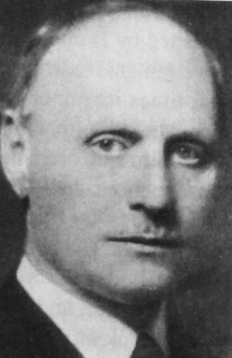
How to make splits?
Which variable to use?
Where to split?
Cholesterol > ____
Systolic BP > _____
Idea – Pick BP cutoff to minimize p-value for χ²
Split point data-derived!
What does “significance” mean now?
Fix (Bonferroni): (p-value)x(number of splits) < 0.05
O O O
Carlo
Emilio
Bonferroni

Slide 10
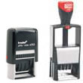

Validation
Traditional stats – small dataset, need all observations to estimate parameters of interest.
Data mining – loads of data, can afford “holdout sample”
Variation: n-fold cross validation
Randomly divide data into n sets
Estimate on n-1, validate on 1
Repeat n times, using each set as holdout.
Framingham example did not use holdout.

Slide 11


Pruning
Grow bushy tree on the “fit data”
Classify validation (holdout) data
Likely farthest out branches do not improve, possibly hurt fit on validation data
Prune non-helpful branches.
What is “helpful”? What is good discriminator criterion?

Slide 12
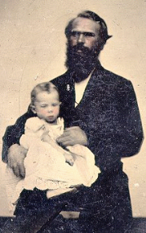
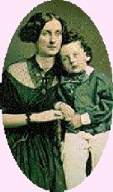

Goals
Split (or keep split) if diversity in parent “node” > summed diversities in child nodes
Prune to optimize
Estimates
Decisions
Ranking
in validation data

Slide 13
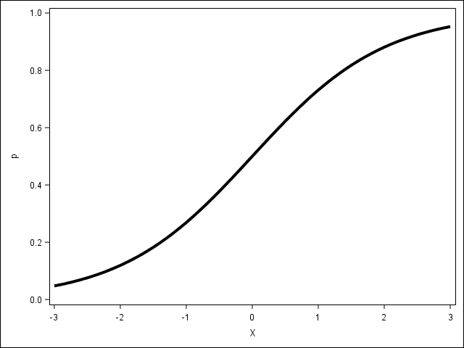
Assessment for:
Decisions Minimize incorrect model decisions (versus realized)
Estimates Error Mean Square (average squared error)
Ranking C (concordance) statistic = proportion concordant + ½ (proportion tied)
Obs number 1 2 3 4 5
Actual 0 (0,1) 1 0 (1 means “event”)
Probability of 1 0.2 0.3 0.6 0.7 (← from model)
Concordant Pairs: (1,3) (1,4) (2,4)
Discordant Pairs: (3,5) (4,5)
Tied (2,3)
6 ways to get pair with 2 different responses
C = 3/6 + (1/2)(1/6) = 7/12=0.5833= ROC area
1 1
0 0 0
0.2 0.3 0.6 0.7 pr{1}

Slide 14

Accounting for Costs
Pardon me (sir, ma’am) can you spare some change?
Say “sir” and prefers male +$2.00
Say “ma’am” and prefers female +$5.00
Say “sir” but prefers female -$1.00 (balm for slapped face)
Say “ma’am” but prefers male -$10.00 (nose splint)

Slide 15
Including Probabilities
Leaf has Pr(M)=.4, Pr(F)=.6 You say:
Sir Ma’am
Expected profit is
2(0.4)-1(0.6) = $0.20
if I say “sir”
Expected profit is
-4+3 = -$1.00 (a loss)
if I say “Ma’am”
Weight leaf profits by leaf size (# obsns.) and sum.
Prune (and split) to maximize profits.
Actual Preference
M 40%
F 60%
0.4 (+2)
0.4 (-10)
0.6 (-1)
0.6 (+5)
+$0.20 -$1.00

Slide 16
Regression Trees
Continuous response Y
Predicted response P_{i} constant in regions i=1, …, 5
Predict 80
Predict 50
X₂
Predict
130
Predict
20
Predict 100
X₁

Slide 17
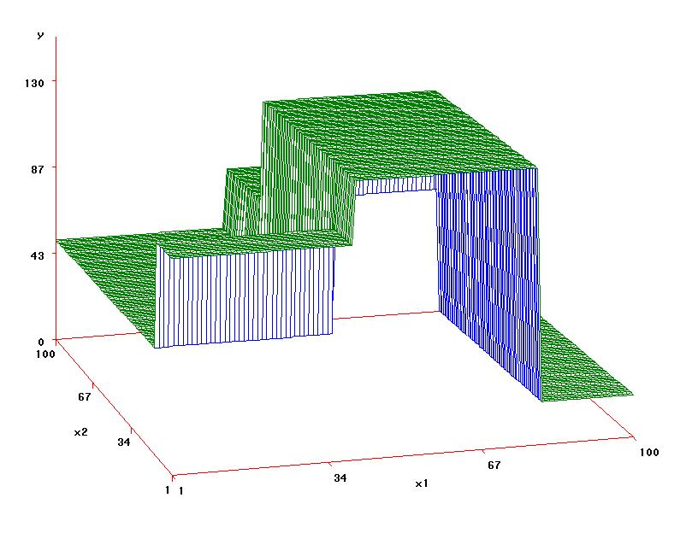
Regression Trees
Predict P_{i} in cell i.
Y_{ij} j^{th} response in cell i.
Split to minimize Σ_{i} Σ_{j} (Y_{ij}-P_{i})²

Slide 18
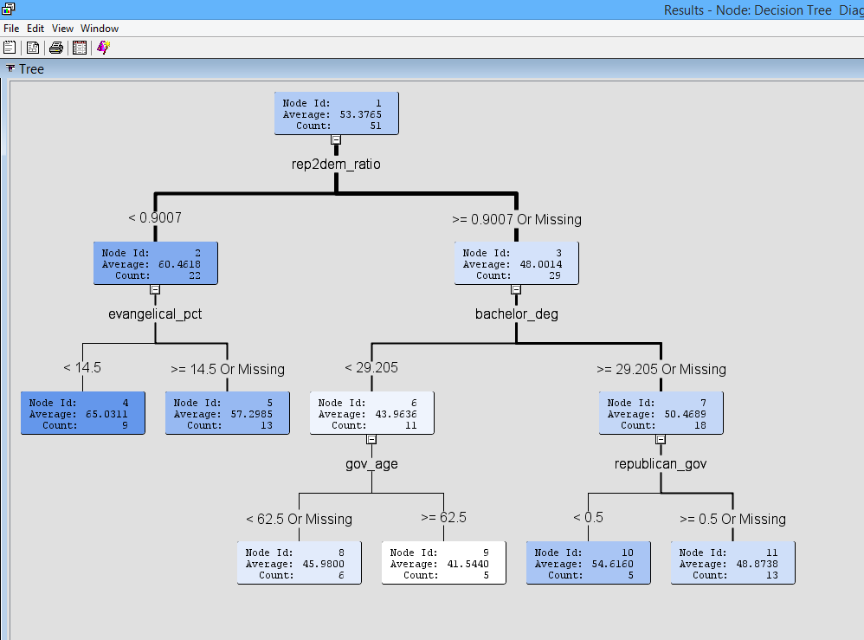




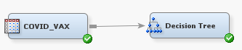
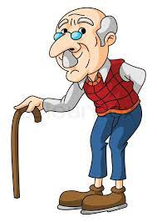


% Vaccinated by State
←SSE = 3295
D
R
R/D
,R/D,
60%
48%
44%
50%
65%
57%
D
R
Σ (SSEs) = 572
46%
42%
55%
49%

Slide 19
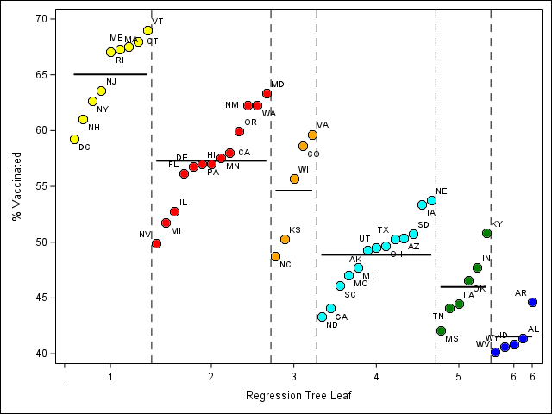
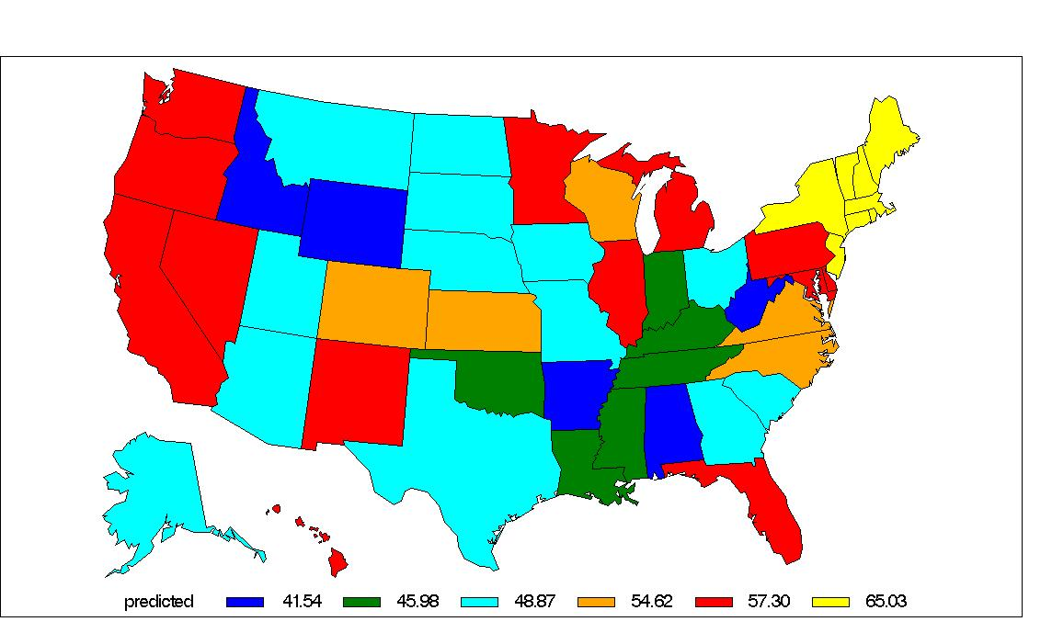

statecode
vaxpct Target
rep2dem_ratio (leans Rep)/(leans Dem)
bachelor_deg % w Bachelors Degree
evangelical_pct % Evangelical Christian
gov_age Governor’s Age
republican_gov Republican Governor?
catholic_pct % Catholics
Birth Births per 1000 eligible women
Death Deaths per 100000 people
Med_Hhold_Inc Median Household Income
MedianAge Median Age
Methodist_pct % Methodist
US_IO Net immigration domestic per 1000 01Jul2018 - 01Jul2019
World_IO Net immigration international 01Jul2018 -01Jul2019
advanced_deg % w Advanced Degree
highschool_deg % w High School Diploma
male_pct % Male
population Population
white_pct_2012 % White
Predicted vaccination %
Actual and Predicted vaccination %
R
D
Governor
Governor
D
R > .9D .9D > R

Slide 20
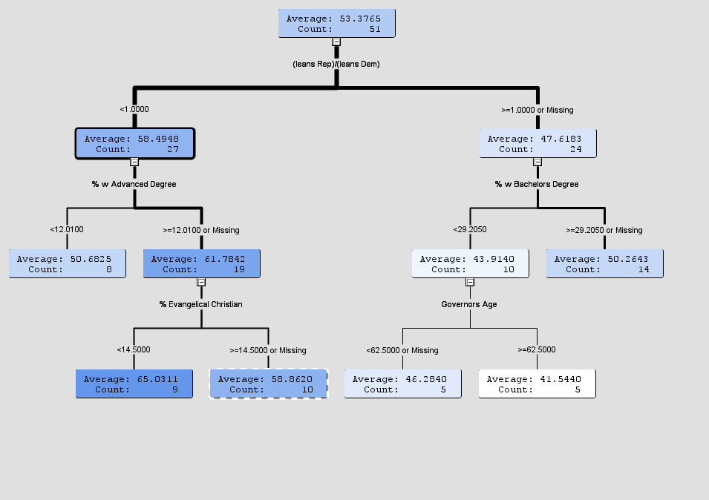
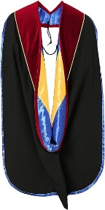

Interactive – force first split at R% / D%=1
← 53% vaccinated overall
MoreD
More R
1.00
58%
48%
62%
44%
50%
51%
65%
59%
6
Leaf=1
46%
42%
Σ (SSEs) = 572

Slide 21
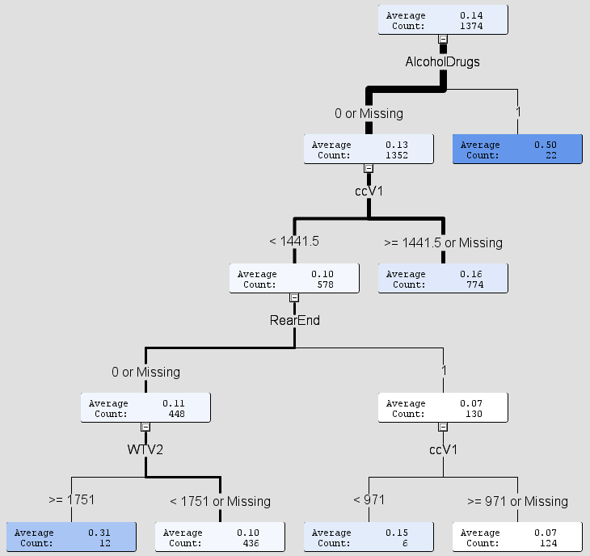



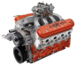

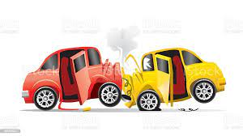

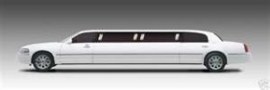
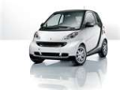
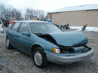

$ $
Real data example: Traffic accidents in Portugal*
Y = injury induced “cost to society” (in multiples of cost of 1 death)
According to the NSC,
the cost per death is
D = $1.41 million
* Tree developed by Guilhermina Torrao, (used with permission)
NCSU Institute for Transportation Research & Education
$ $
0.50 D
0.16 D
0.31 D
0.10 D
0.07 D
Help - I ran
Into a “tree”
0.15 D
Help - I ran
Into a “tree”

Slide 22
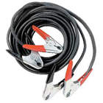
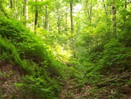
Extensions of tree based methods:
Boosting - build a tree, take residuals. Build a second tree
on the residuals from first to fix mistakes. Take
residuals, build a new tree etc.
(2) Random Forests – sample from the observations and variables.
Build multiple trees, one for each sample
Combine information from all trees.
(i.e. use an ensemble model)

Slide 23
Logistic Regression
Logistic – another classifier
Older – “tried & true” method
Predict probability of response from input variables (“Features”)
Linear regression gives infinite range of predictions
0 < probability < 1 so not linear regression.

Slide 24

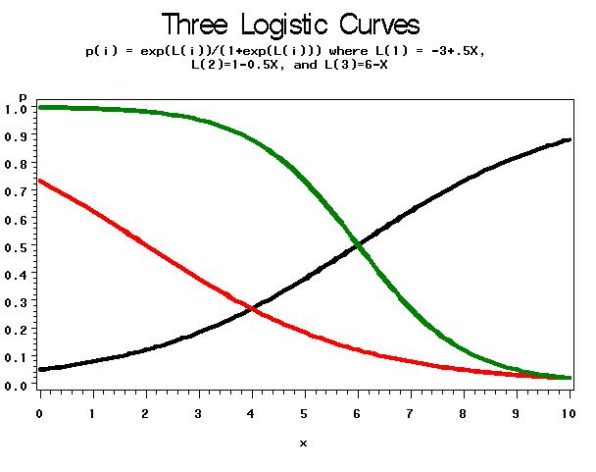
Logistic Regression
e^{a+bX}
(1+e^{a+bX})
Three Logistic Curves
→p
X

Slide 25

Example: Seat Fabric Ignition
Flame exposure time = X
Y=1 → ignited, Y=0→ did not ignite
Y=0, X= 3, 5, 9 10 , 13, 16
Y=1, X = 7 11, 12 14, 15, 17, 25, 30
Q=(1-p₁)(1-p₂)p₃(1-p₄)(1-p₅)p₆p₇(1-p₈)p₉p₁₀(1-p₁₁)p₁₂p₁₃p₁₄
p’s all different p_{i} = f(a+bX_{i}) = e^{a+bXi}/(1+e^{a+bXi})
Find a,b to maximize Q(a,b)

Slide 26
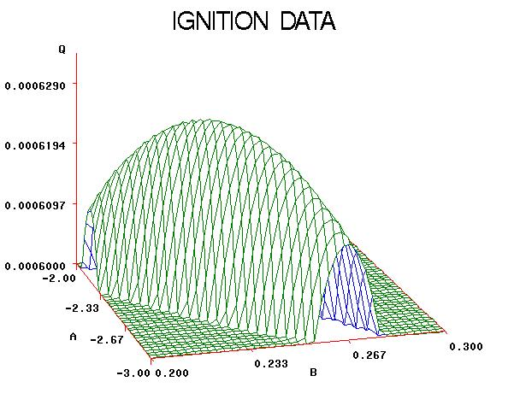
Logistic idea:
Given temperature X, compute L(x)=a+bX then p = e^{L}/(1+e^{L})
p(i) = e^{a+bXi}/(1+e^{a+bXi})
Write p(i) if event, 1-p(i) if not
Multiply all n of these together, find a,b to maximize this “likelihood”
Logistic: L = -2.59 + 0.23X
maximize Q(a,b) = Likelihood
Likelihood
-2.6
-2.6
a
b
0.23
0.23

Slide 27
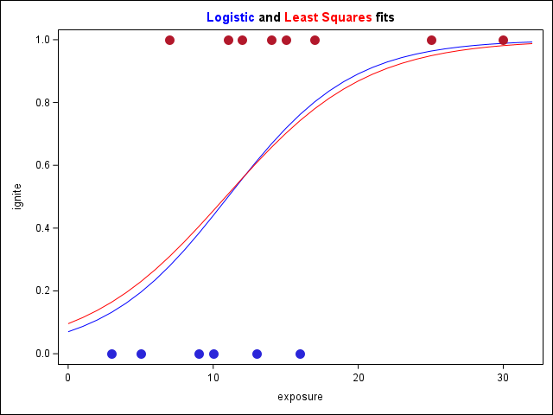
Least squares idea:
Given temperature X, compute L(x)=a+bX then p = e^{L}/(1+e^{L})+error
p(i) = e^{a+bXi}/(1+e^{a+bXi})
Error = 1-p(i) if event, 0-p(i) if not
Square errors and sum, find a,b to minimize this “SS(error)”
Estimated L = -2.25+ 0.21X
Versus L = -2.59 + 0.23X

Slide 28
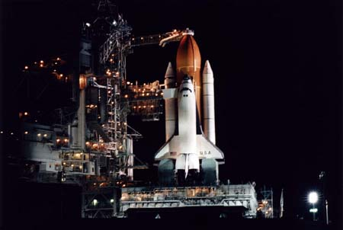

Slide 29

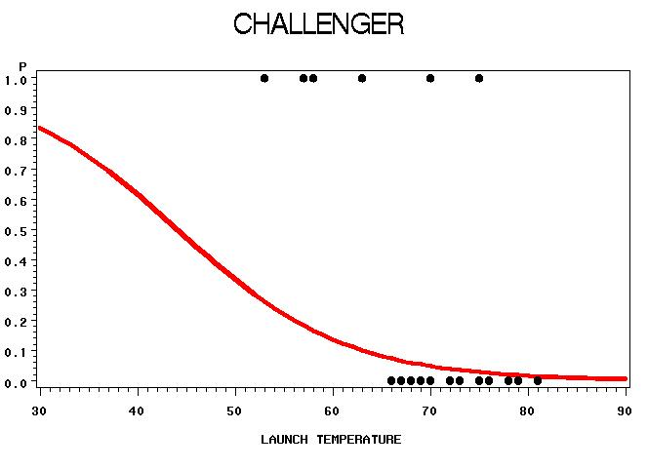
Example: Shuttle Missions
O-rings failed in Challenger disaster
Prior flights “erosion” and “blowby” in O-rings (6 per mission)
Feature: Temperature at liftoff
Target: (1) - erosion or blowby vs. no problem (0)
L=5.0850 – 0.1156(temperature)
p = e^{L}/(1+e^{L})

Slide 30
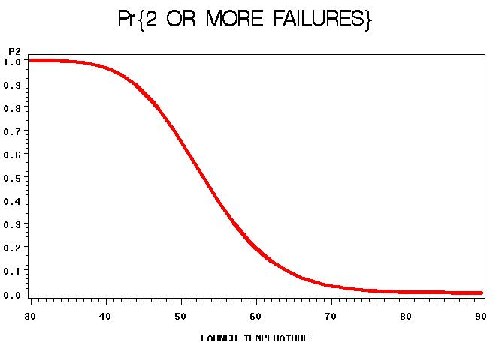

Slide 31
Neural Networks
X₁
H₁
(0,1)
inputs
X₂
Output = Pr{1}
Very flexible functions
“Hidden Layers”
“Multilayer Perceptron”
X₃
H₂
Logistic function of
Logistic functions **
Of data
X₄
** (note: Hyperbolic tangent functions are just reparameterized logistic functions)

Slide 32
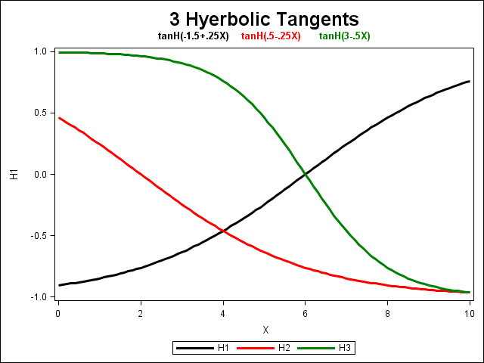
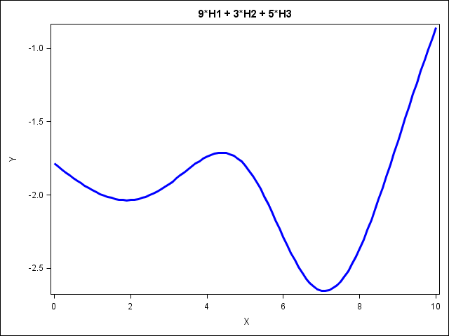
Example:
Y = a + b₁ H1 + b₂ H2 + b₃ H3
Y = 0 + 9 H1 + 3 H2 + 5 H3
“bias”
-1 to 1
“weights”
H₁
b₁
H₂
b₂
X
Y
b₃
H₃
Arrows on right represent linear
combinations of “basis
functions,” e.g. hyperbolic tangents
(reparameterized logistic curves)

Slide 33
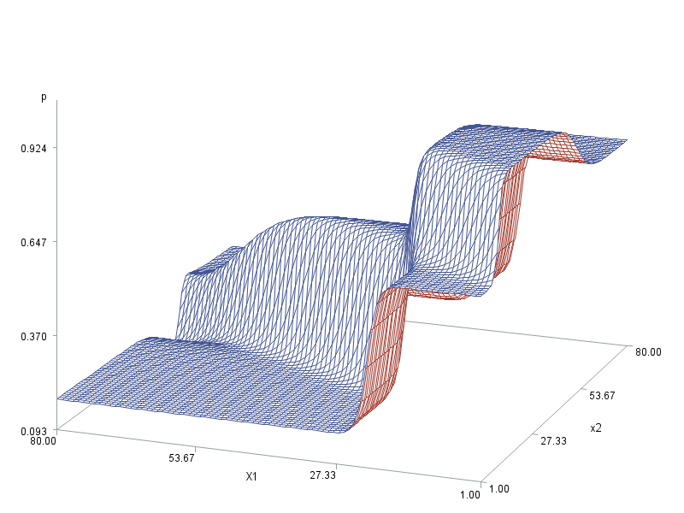
A Complex Neural Network Surface
(-10)
-0.4
3
X1
0.8
X1
(-1)
0
(-13)
-1
P
P
0.25
X2
X2
-0.9
(20)
2.5
0.01
(“biases”)

Slide 34

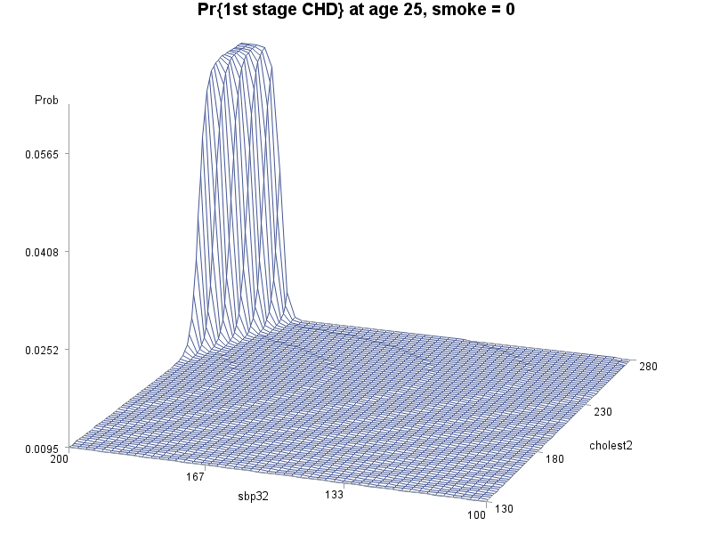
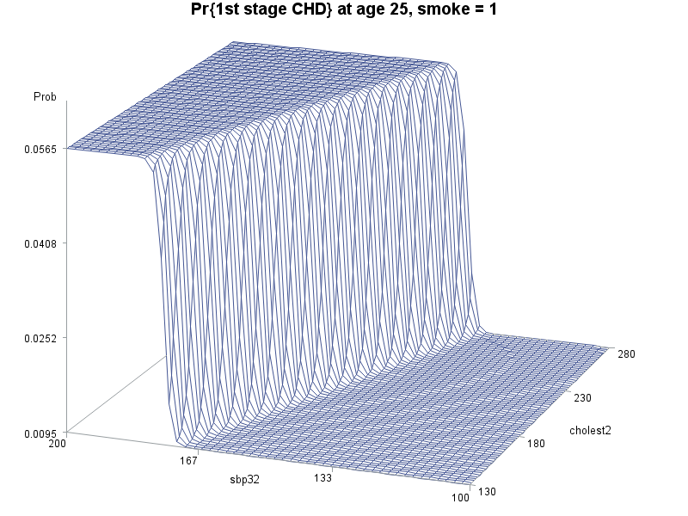
Framingham Neural Network
Note: No validation data used – surfaces are unnecessarily complex
Inputs: Age, Systolic BP, Cholesterol, Smoker
“Slice” of 5-D surface at age=25
Age 25
Nonsmoker
Age 25
Smoker
.057
.001
.057
.001
Cholest
130-280
Cholest
130-280
Sbp
200-100
Sbp
200-100

Slide 35
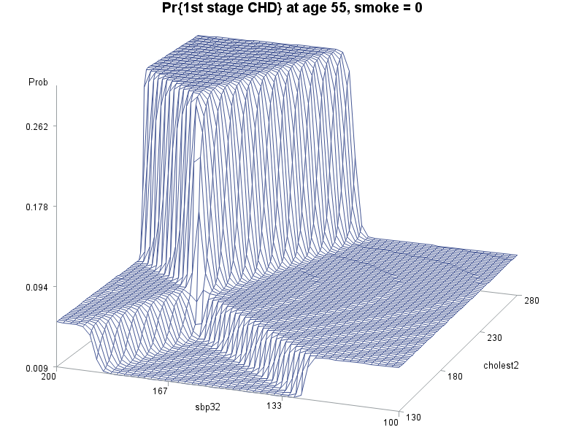
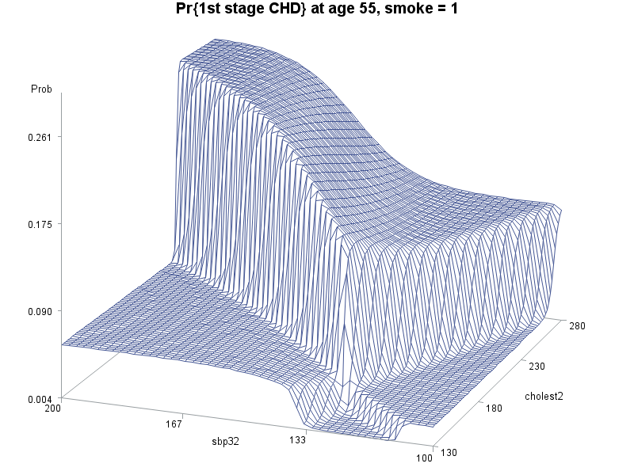
Framingham Neural Network Surfaces
“Slice” at age 55 – are these patterns real?
Age 55
Nonsmoker
Age 55
Smoker
.262
.009
.261
.004
Cholest
130-280
Cholest
130-280
Sbp
200-100
Sbp
200-100

Slide 36
Handling Neural Net Complexity
Use validation data, stop iterating when fit gets worse on validation data.
(2) Use regression to omit predictor variables (“features”) and their parameters. This gives previous graphs. (3) Do both (1) and (2).

Slide 37
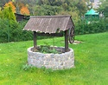




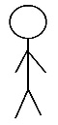
Extension of Neural Networks
“Deep learning”
A multilayer neural network
First layers get overall big picture
Latter layers fill in detail
There is feedback between layers

Slide 38
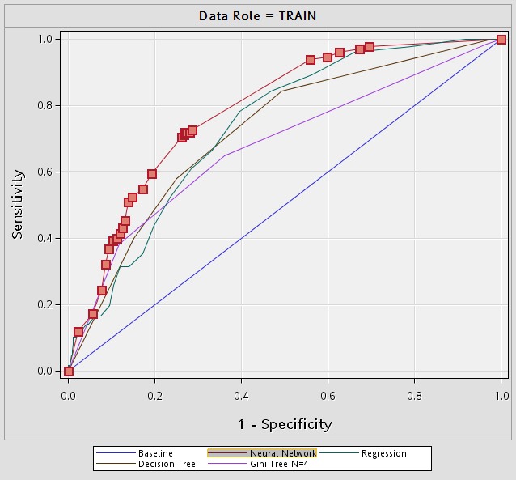
← Framingham ROC for 4 models
and baseline 45 degree line
Neural net highlighted, area 0.780
Sensitivity: Pr{ calling a 1 a 1 }=Y coordinate Specificity; Pr{ calling a 0 a 0 } = 1-X.
Selected Model | Model Node | Model Description | Misclassification Rate | Avg. Squared Error | Area Under ROC
Y | Neural | Neural Network | 0.079257 | 0.066890 | 0.780
 | Tree | Decision Tree | 0.079257 | 0.069369 | 0.720
 | Tree2 | Gini Tree N=4 | 0.079257 | 0.069604 | 0.675
 | Reg | Regression | 0.080495 | 0.069779 | 0.734

Slide 39
Three Breast Cancer Models
Features are computed from a digitized image of a fine needle
aspirate (FNA) of a breast mass. They describe characteristics
of the cell nuclei present in the image.
1. Sample code number id number
2. Clump Thickness 1 - 10
3. Uniformity of Cell Size 1 - 10
4. Uniformity of Cell Shape 1 - 10
5. Marginal Adhesion 1 - 10
6. Single Epithelial Cell Size 1 - 10
7. Bare Nuclei 1 - 10
8. Bland Chromatin 1 - 10
9. Normal Nucleoli 1 - 10
10. Mitoses 1 - 10
11. Class: (2 for benign, 4 for malignant)

Slide 40
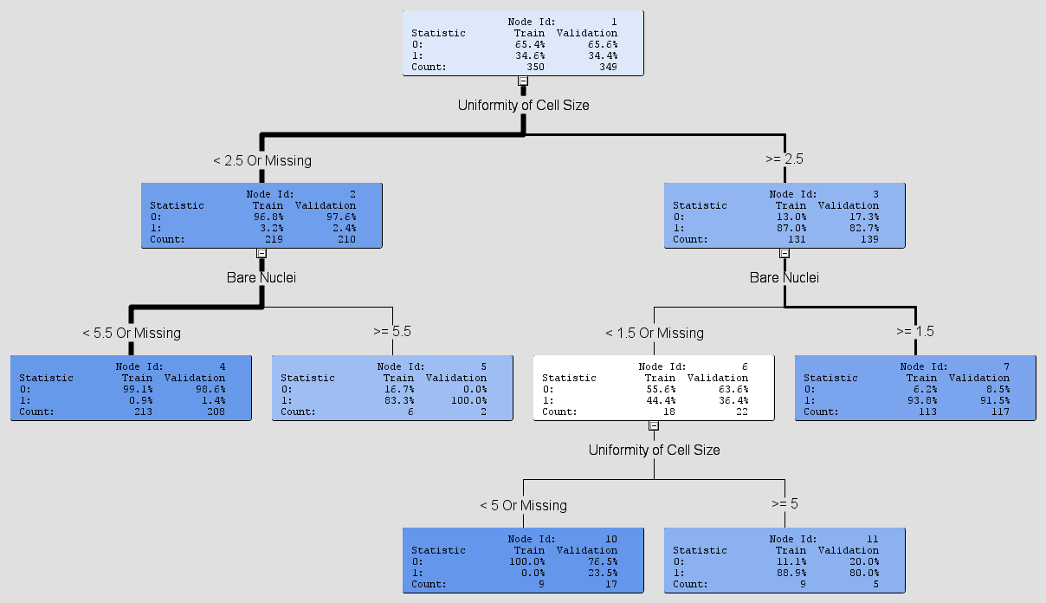
Decision Tree Needs Only BARE & SIZE

Slide 41
Cancer Screening Results: Model Comparison Node
Selected Model | Model Node | Model Description | Train Misclassification Rate | Train Avg. Squared Error | Train Area Under ROC | Validation Misclassification Rate | Validation Avg. Squared Error | Validation Area Under ROC
Y | Tree | Decision Tree | 0.031429 | 0.029342 | 0.975 | 0.051576 | 0.048903 | 0.933
 | Neural | Neural Network | 0.031429 | 0.025755 | 0.994 | 0.054441 | 0.037838 | 0.985
 | Reg | Regression | 0.031429 | 0.029322 | 0.992 | 0.054441 | 0.040768 | 0.987

Slide 42
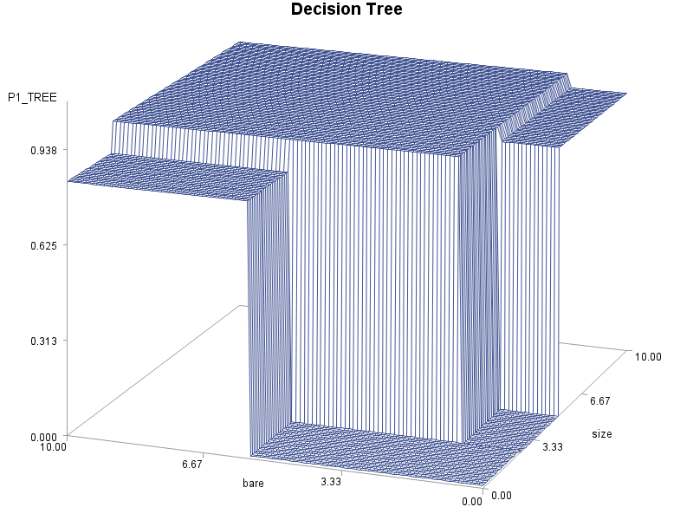
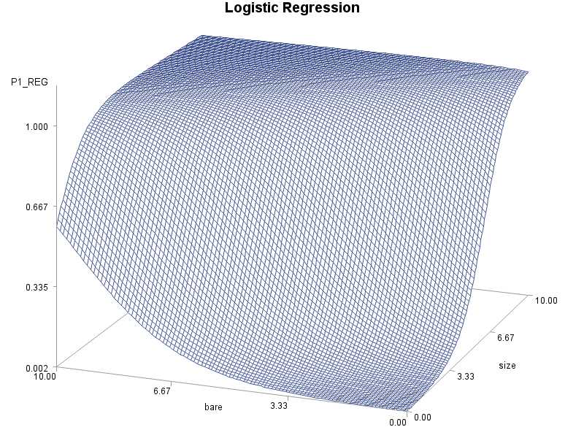
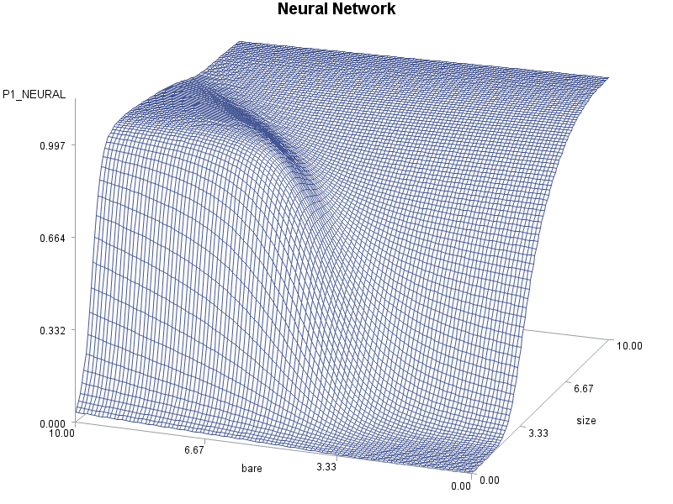
Validation Misclassification Rate 0.0516
Validation Misclassification Rate 0.0544
Validation Misclassification Rate 0.0544

Slide 43
Unsupervised Learning
We have the “features” (predictors)
We do NOT have the response even on a training data set (UNsupervised)
Another name for clustering
SAS Enterprise Miner
Large number of clusters with k-means (k clusters)
Ward’s method to combine (less clusters , say r<k)
One more k means for final r-cluster solution.

Slide 44
Unsupervised Learning
K means – place spread out seeds
Cluster to closest seed (centroid)
Compute new centroid
Repeat
Ward – Σ (sum of squared distances from centroids).
Combine 2 that minimally increase Σ (sum of squares).
Repeat

Slide 45
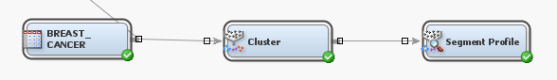


Example: Cluster the breast cancer data (disregard target)
Plot clusters and actual target values:

Slide 46
Multidimensional Scaling
MORPH !
-2.6667 -0.3333 3.0000
Figure in 2D
Reduce to 1D ??? - no!
B
3
4
3
A
B
|
0
C
4
A
B
C
A
5
5
C
Can we get close in some sense? (e.g. least squares)
Dependent Predicted
Obs Variable Value Residual
1 5 5.6667 -0.6667
2 3 2.3333 0.6667
3 4 3.3333 0.6667
4 0 0 0
X matrix
A B C Y
-1 0 1 5
-1 1 0 3
0 -1 1 4
1 1 1 0
-2.6667
-0.3333
3.0000
b = (X’X)⁻¹X’Y =

Slide 47
Association Analysis is just elementary probability with new names
0.3
Pr{B}=0.3
A
A: Purchase Milk
B: Purchase Cereal
Pr{A and B}
= 0.2
B
Pr{A} =0.5
0.1
0.4
0.3+0.2+0.1+0.4 = 1.0

Slide 48
Cereal=> Milk
Rule B=> A “people who buy B will buy A”
Support:
Support= Pr{A and B} = 0.2
Independence means that Pr{A|B} = Pr{A} = 0.5
Pr{A} = 0.5 = Expected confidence if there is no
relation to B.
Confidence:
Confidence = Pr{A|B}=Pr{A and B}/Pr{B}=2/3
??- Is the confidence in B=>A the same as the
confidence in A=>B?? (yes, no)
Lift:
Lift = confidence / E{confidence} = (2/3) / (1/2) = 1.33
Gain = 33%
A
B
0.2
←0.1
0.3
0.4
B
Marketing A to the 30%
of people who buy B will
result in 33% better sales
than marketing to a random
30% of the people.

Slide 49

Example: Grocery cart items (hypothetical)
Sort Criterion: Confidence
Maximum Items: 2
Minimum (single item) Support: 20%
item cart
bread 1
milk 1
soap 2
meat 3
bread 3
bread 4
cereal 4
milk 4
soup 5
bread 5
cereal 5
milk 5
Association Report
Expected
Confidence Confidence Support Transaction
Relations (%) (%) (%) Lift Count Rule
2 63.43 84.21 52.68 1.33 8605 cereal ==> milk
2 62.56 83.06 52.68 1.33 8605 milk ==> cereal
2 63.43 61.73 12.86 0.97 2100 meat ==> milk
2 63.43 61.28 38.32 0.97 6260 bread ==> milk
2 63.43 60.77 12.81 0.96 2093 soup ==> milk
2 62.54 60.42 38.32 0.97 6260 milk ==> bread
2 62.56 60.28 37.70 0.96 6158 bread ==> cereal
2 62.54 60.26 37.70 0.96 6158 cereal ==> bread
2 62.56 60.16 12.69 0.96 2072 soup ==> cereal
2 21.08 20.28 12.69 0.96 2072 cereal ==> soup
2 20.83 20.27 12.86 0.97 2100 milk ==> meat
2 21.08 20.20 12.81 0.96 2093 milk ==> soup

Slide 50

Link Graph →
Sort Criterion: Confidence
Maximum Items: 3
e.g. milk & cereal➔bread
Minimum Support: 5%
Slider bar at 62%

Slide 51

Support Vector Machines
Find a point X₀ that “optimally” separates red from blue.
Optimally separate events from non-events.
Maximize the “margin” & take midpoint
“margin”

Slide 52

Support Vector Machines
Let Z=1 for events, Z = -1 for non-events
Minimize slope of line subject to YZ>=1 everywhere
Y= -16.38 + 32.73 X so X₀=16.38/32.73=0.50
Y>=1 and
Z = 1
Y<= - 1 and
Z = - 1

Slide 53

What about higher dimensions? Separator is a line (not point).
Data completely separated by many lines
Which line maximizes margin?

Slide 54
What about higher dimensions? Separator is a line (not point).
Data completely separated by many lines
Which line maximizes margin?

Slide 55

Add a Z dimension (Z=-1 or 1).
Which line maximizes margin?

Slide 56
Add a Z dimension (Z=-1 or 1).
Plane: Y = -1 + 0.25*X1-0.20*X2
←Y=Z=1
←Y=0
←Y=Z=1

Slide 57
| = Maximum Margin Classifier (Z=-1 or 1).

Slide 58


Minimize slope subject to all YZ>1
Y = -1 + 0.25*X1 – 0.20* X2

Slide 59


Slide 60

Credit card payments versus
debt to income ratio .
Pay off card Pay interest only default
4.5
7.5
4
8
5
7
X = debt to income ratio .

Slide 61


Plane:
Y= (-67 + 24X₁ – 2X₂ )/3
Idea: plot Z against X1=X and X2 = X²
Move to “higher dimension” to get linear separation (plane) Y= (-67 + 24X₁ – 2X₂ )/3
X₂=-33.5+12X₁
_{(where Y=0)}

Slide 62


Look into the floor
Plane hits Z=-1 at X=4 and 8, (b+4c= -1)
Z=1 at X=5 and 7 (b+c=1)
Corresponding quadratic: f(X,X²) =b+ c(X-6)² b+4c=1, b+c=-1, c=-2/3, b=-5/3
f(X,X²) = -(2X²-24X+67)/3
Pay off card Pay interest only default
Pay off card Pay interest only default
Line
Y = -2(X-7.5)
Not quadratic
Plane: Y=0 at X=7.5
Quadratic: Y=0 at
X=7.58 (root)
Note: Quadratic (2X²-24X+67)/3 and plane 2(X-7.5) hit 1 and -1 at the same X values

Slide 63


Existence:
Can always split with
Y=c(X-r₁)(X-r₂)(X-r₃)
Best Y?
Maximizes margin?
Dimensions:
X1=X
X2=X²
X3=X³
r₁
r₂
r₃

Slide 64




Example in 2-D
X3=X1*X1+X2*X2
Dimensions:
(X1,X2,X3,Y)
X1, X2,
X3=X1*X1+X2*X2
Z=-1 or 1
(no Z axis shown)
X3
X3=X1*X1+X2*X2
X3

Slide 65
Reality: Events and non-events typically mingled
Need to lighten up on ZY-1 >= 0 requirement !
This plus the move to higher dimension is full
blown support vector technology.

Slide 66

Comparing Decision Boundaries for SVM Data
Warning message from PROC LOGISTIC
Model Convergence Status
Complete separation of data points detected.
WARNING: The maximum likelihood estimate does not exist.
WARNING: The LOGISTIC procedure continues in spite of the above warning. Results shown are based
on the last maximum likelihood iteration. Validity of the model fit is questionable.

Slide 67
Text Mining
Hypothetical collection of news releases (“corpus”) :
release 1: Did the NCAA investigate the basketball scores and
vote for sanctions?
release 2: Republicans voted for and Democrats voted against
it for the win.
(etc.)
Compute word counts:
NCAA basketball score vote Republican Democrat win
Release 1 1 1 1 1 0 0 0
Release 2 0 0 0 2 1 1 1

Slide 68
Text Mining Mini-Example: Word counts in 14 e-mails
←--------------------------------words-----------------------------------------→
R B T
P e a o
d E r p s D u
o l e u k e r S S
c e s b e m V n S c c
u c i l t o o a p o o
m t d i b c t N L m e W r r
e i e c a r e C i e e i e e
n o n a l a r A a n c n _ _
t n t n l t s A r t h s V N
1 20 8 10 12 6 0 1 5 3 8 18 15 21
2 5 6 9 5 4 2 0 9 0 12 12 9 0
3 0 2 0 14 0 2 12 0 16 4 24 19 30
4 8 9 7 0 12 14 2 12 3 15 22 8 2
5 0 0 4 16 0 0 15 2 17 3 9 0 1
6 10 6 9 5 5 19 5 20 0 18 13 9 14
7 2 3 1 13 0 1 12 13 20 0 0 1 6
8 4 1 4 16 2 4 9 0 12 9 3 0 0
9 26 13 9 2 16 20 6 24 4 30 9 10 14
10 19 22 10 11 9 12 0 14 10 22 3 1 0
11 2 0 0 14 1 3 12 0 16 12 17 23 8
12 16 19 21 0 13 9 0 16 4 12 0 0 2
13 14 17 12 0 20 19 0 12 5 9 6 1 4
14 1 0 4 21 3 6 9 3 8 0 3 10 20

Slide 69

Eigenvalues of the Correlation Matrix
Eigenvalue Difference Proportion Cumulative
1 7.10954264 4.80499109 0.5469 0.5469
2 2.30455155 1.30162837 0.1773 0.7242
3 1.00292318 0.23404351 0.0771 0.8013
4 0.76887967 0.21070080 0.0591 0.8605
5 0.55817886 0.10084923 0.0429 0.9034
(more)
13 0.0008758 0.0001 1.0000
Variable Prin1
Basketball -.320074
NCAA -.314093
Tournament -.277484
Score_V -.134625
Score_N -.120083
Wins -.080110
Speech 0.273525
Voters 0.294129
Liar 0.309145
Election 0.315647
Republican 0.318973
President 0.333439
Democrat 0.336873
55% of the variation in
these 13-dimensional
vectors occurs in one
dimension.
Prin 2
Prin 1

Slide 70
Eigenvalues of the Correlation Matrix
Eigenvalue Difference Proportion Cumulative
1 7.10954264 4.80499109 0.5469 0.5469
2 2.30455155 1.30162837 0.1773 0.7242
3 1.00292318 0.23404351 0.0771 0.8013
4 0.76887967 0.21070080 0.0591 0.8605
5 0.55817886 0.10084923 0.0429 0.9034
(more)
13 0.0008758 0.0001 1.0000
Variable Prin1
Basketball -.320074
NCAA -.314093
Tournament -.277484
Score_V -.134625
Score_N -.120083
Wins -.080110
Speech 0.273525
Voters 0.294129
Liar 0.309145
Election 0.315647
Republican 0.318973
President 0.333439
Democrat 0.336873
55% of the variation in
these 13-dimensional
vectors occurs in one
dimension.
Prin 2
Prin 1

Slide 71


Sports
Cluster
Politics
Cluster

Slide 72
R B T
P e a o
d E r p s D u
o C l e u k e r S S
c L e s b e m V n S c c
u U P c i l t o o a p o o
m S r t d i b c t N L m e W r r
e T i i e c a r e C i e e i e e
n E n o n a l a r A a n c n _ _
t R 1 n t n l t s A r t h s V N
3 1 -3.63815 0 2 0 14 0 2 12 0 16 4 24 19 30
11 1 -3.02803 2 0 0 14 1 3 12 0 16 12 17 23 8
5 1 -2.98347 0 0 4 16 0 0 15 2 17 3 9 0 1
14 1 -2.48381 1 0 4 21 3 6 9 3 8 0 3 10 20
7 1 -2.37638 2 3 1 13 0 1 12 13 20 0 0 1 6
8 1 -1.79370 4 1 4 16 2 4 9 0 12 9 3 0 0
(biggest gap)
1 2 -0.00738 20 8 10 12 6 0 1 5 3 8 18 15 21
2 2 0.48514 5 6 9 5 4 2 0 9 0 12 12 9 0
6 2 1.54559 10 6 9 5 5 19 5 20 0 18 13 9 14
4 2 1.59833 8 9 7 0 12 14 2 12 3 15 22 8 2
10 2 2.49069 19 22 10 11 9 12 0 14 10 22 3 1 0
13 2 3.16620 14 17 12 0 20 19 0 12 5 9 6 1 4
12 2 3.48420 16 19 21 0 13 9 0 16 4 12 0 0 2
9 2 3.54077 26 13 9 2 16 20 6 24 4 30 9 10 14
P
r
i
n
1
Sports
Documents
Politics
Documents

Slide 73

PROC CLUSTER (single linkage) agrees !
Cluster 2
Cluster 1

Slide 74
Fisher’s Linear Discriminant Analysis
- an older method of classification
(optional)
Assumes multivariate normal distribution
of inputs (features)
Computes a “posterior probability” for each
of several classes, given the observations.
Based on statistical theory

Slide 75

Example:
One input,
(financial
stress index)
Three
Populations:
(pay all credit
card debt,
pay part,
default).
Normal distributions with same variance. Classify a credit card holder by financial
stress index: pay all (stress<20), pay part (20<stress<27.5), default(stress>27.5)
Data are hypothetical. Means are 15, 25, 30.

Slide 76

Example:
Differing
variances.
Not just
closest
mean now.
Normal distributions with different variances. Classify a credit card holder by financial
stress index: pay all (stress<19.48), pay part (19.48<stress<26.40),
default(26.40<stress<36.93), pay part (stress>36.93)
Data are hypothetical. Means are 15, 25, 30. Standard Deviations 3,6,3.

Slide 77

Example:
20% defaulters,
40% pay part
40% pay all
Normal distributions with same variance and “priors.” Classify a credit card holder by
financial stress index: pay all (stress<19.48), pay part (19.48<stress<28.33),
default(28.33<stress<35.00), pay part (stress>35.00) Data are hypothetical.
Means are 15, 25, 30. Standard Deviations 3,6,3. Population size ratios 2:2:1

Slide 78


Example:
Two inputs,
three
populations
Multivariate
normals, same
2x2 covariance
matrix.
Viewed from
above, boundaries
appear to be linear.

Slide 79

Defaults
Pays
part
only
debt
Pays
in
full
Income

Slide 80



Score Data (grid)
scored
by Enterprise
Miner Nearest
Neighbor
method
Original Data
Original Data
scored
by Enterprise
Miner Nearest
Neighbor
method

Slide 81

Memory Based Reasoning
(optional)
Usual name: Nearest Neighbor Analysis
Probe Point
9 blue
7red
Classify as
BLUE
Estimate Pr{Blue}
as 9/16

Slide 82

Note: Enterprise
Miner Exported
Data Explorer
Chooses colors
→

Slide 83


Receiver Operating Characteristic Curve
Cut point 1
Logits of 1s Logits of 0s
red black
Logits of 1s Logits of 0s
red black
Select most likely p₁% according to model.
Call these 1, the rest 0. (call almost everything 0)
Y=proportion of all 1’s correctly identified.(Y near 0)
X=proportion of all 0’s incorrectly called 1’s (X near 0)
(or any model predictor
from most to least likely
to respond)

Slide 84


Receiver Operating Characteristic Curve
Cut point 2
Logits of 1s Logits of 0s
red black
Logits of 1s Logits of 0s
red black
Select most likely p₂% according to model.
Call these 1, the rest 0.
Y=proportion of all 1’s correctly identified.
X=proportion of all 0’s incorrectly called 1’s

Slide 85


Receiver Operating Characteristic Curve
Cut point 3
Logits of 1s Logits of 0s
red black
Logits of 1s Logits of 0s
red black
Select most likely p₃% according to model.
Call these 1, the rest 0.
Y=proportion of all 1’s correctly identified.
X=proportion of all 0’s incorrectly called 1’s

Slide 86


Receiver Operating Characteristic Curve
Cut point 3.5
Logits of 1s Logits of 0s
red black
Select most likely 50% according to model.
Call these 1, the rest 0.
Y=proportion of all 1’s correctly identified.
X=proportion of all 0’s incorrectly called 1’s

Slide 87


Receiver Operating Characteristic Curve
Cut point 4
Logits of 1s Logits of 0s
red black
Select most likely p₅% according to model.
Call these 1, the rest 0.
Y=proportion of all 1’s correctly identified.
X=proportion of all 0’s incorrectly called 1’s

Slide 88


Receiver Operating Characteristic Curve
Cut point 5
Logits of 1s Logits of 0s
red black
Logits of 1s Logits of 0s
red black
Select most likely p₆% according to model.
Call these 1, the rest 0.
Y=proportion of all 1’s correctly identified.
X=proportion of all 0’s incorrectly called 1’s

Slide 89


Receiver Operating Characteristic Curve
Cut point 6
Logits of 1s Logits of 0s
red black
Select most likely p₇% according to model.
Call these 1, the rest 0.(call almost everything 1)
Y=proportion of all 1’s correctly identified. (Y near 1)
X=proportion of all 0’s incorrectly called 1’s (X near 1)

Slide 90


Good Loan Bad Loan versus Financial Stress 1 ROC Curve
Means: 3 and 4

Slide 91


Good Loan Bad Loan versus Financial Stress 1 ROC Curve
Means: 3.5 and 5.7

Slide 92


Good Loan Bad Loan versus Financial Stress 2 ROC Curve
Means: 3 and 6

